Slide 1
CSE 417T Introduction to Machine Learning
Review of Exam 1 Instructor: Chien-Ju (CJ) Ho

Slide 2
Logistics: Exam 1
Exam 1 Date: October 27 (Thursday)
In-class exam (the same time/location as the lecture)
Exam duration: 75 minutes
Planned exam content: LFD Chapter 1 to 5
Everything in textbook/lectures are included, except for parts labeled as “safe to skip”.
2 sections of questions
~5 long questions (written response questions with explanations required)
10 multiple choice questions (select one option, no explanations needed)
Closed-book exam. You can bring two cheat-sheets
Up to letter size, front and back (up to 4 pages)
No format limitations (it can be typed, written, or a combination)
No calculators (you don’t need them)

Slide 3
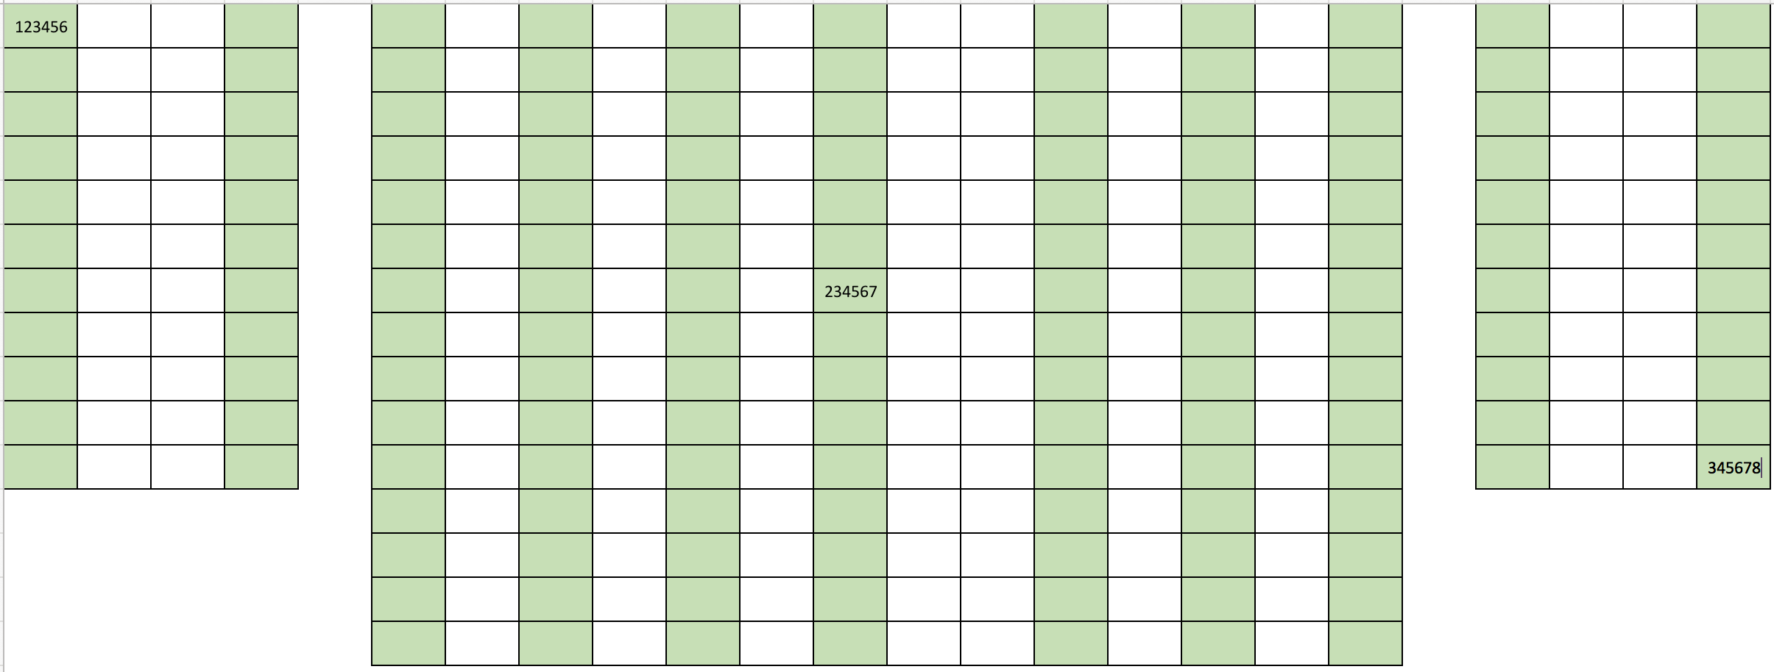
Logistics: Exam Policies
I might arrange random seat assignments
Will be announced on Piazza the night before the exam if I do

Slide 4
Logistics: Exam Policies
Please arrive on time. No extensions will be given if you arrive late.
During the exam, if you have a question or if you finish before time is up:
Do not get up
Raise your hand and I will come to you
I most likely will not answer questions to individual students
But I’ll give clarifications to everyone if multiple students ask the same question
When time is called:
Stop writing
Do not get up
We will explain how to turn in your exam papers

Slide 5
Homework
Solution Sketch of HW3 has been posted on Gradescope
Not intended to be comprehensive
Requests for extensions
The answer is no by default
Exception: documented medical/family emergencies

Slide 6
Plans for Today
A short summary of the content of Exam 1.
Discussion of the practice questions.
Discussion of any other questions you might have.

Slide 7
Review for Exam 1
Brief overview on the content.
Not comprehensive and not covering everything that could appear in the exam.
Please make sure you still study for LFD Chapter 1-5.
Let me know if you find mistakes in lecture notes.
Whenever you have doubts on the lecture notes, please use the textbook for the confirmation.

Slide 8
Chap 1: Setting up the learning problem
Problem setup
probability assumptions/inferences
error and noise
Chap 2: Theory of generalization (training v.s. testing)
Hoeffding’s inequality
VC theory
Bias-variance decomposition
Chap 3: Linear models
Linear classification/regression
logistic regression, gradient descent
nonlinear transformations
Chap 4: Overfitting
Overfitting
Regularization and validation
Chap 5: Three learning principles
Occam’s razor, sampling bias, data snooping

Slide 9
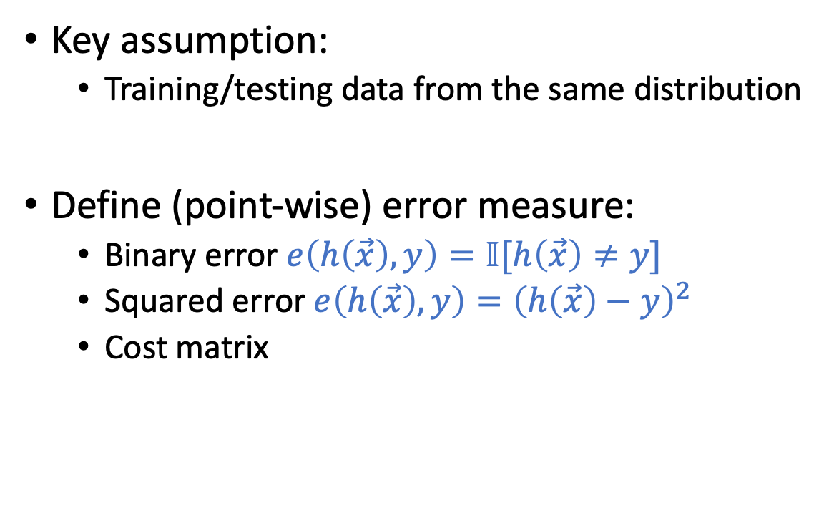
Setup of the Learning Problem
Key assumption:
Training/testing data from the same distribution
Define (point-wise) error measure:
Binary error $e\left(h\left(\vec{x}\right),y\right)=𝕀[h\left(\vec{x}\right)≠y]$
Squared error $e\left(h\left(\vec{x}\right),y\right)={\left(h\left(\vec{x}\right)−y\right)}^{2}$
Cost matrix

Slide 10
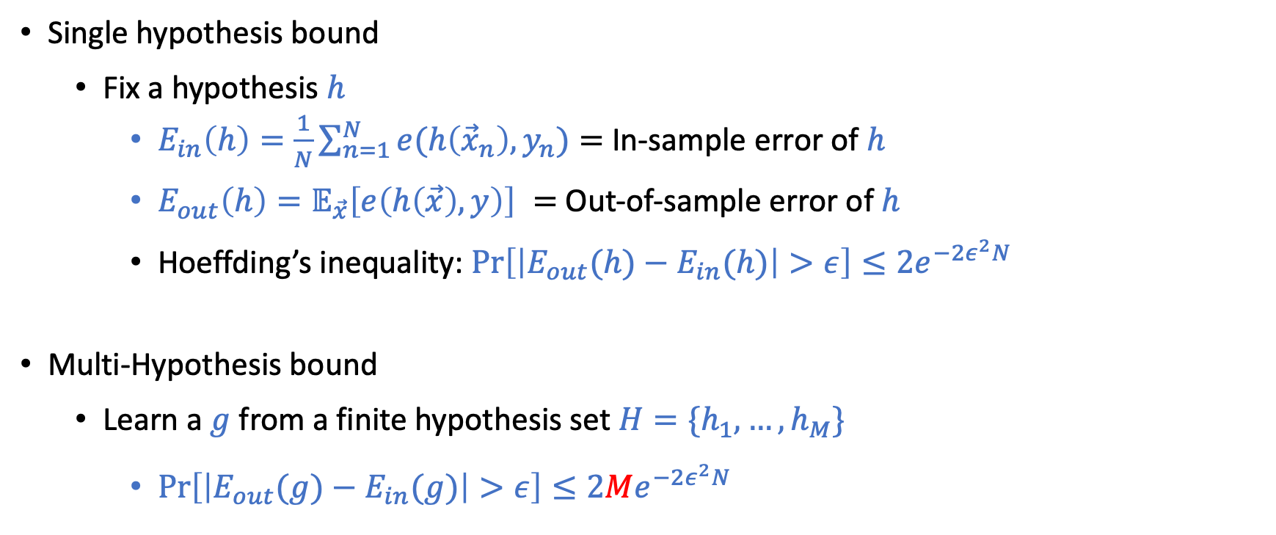
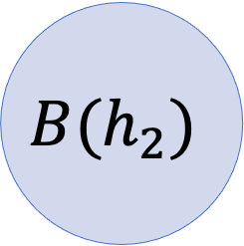
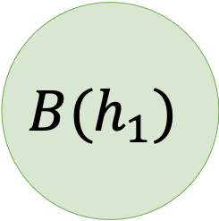
Hoeffding’s Inequality
Draw with replacement
Single hypothesis bound
Fix a hypothesis $h$
$E_{in}\left(h\right)=\frac{1}{N}\sum_{n=1}^{N}{e(h\left({\vec{x}}_{n}\right),y_{n})}=$ In-sample error of $h$
$E_{out}\left(h\right)=𝔼_{\vec{x}}\left[e\left(h\left(\vec{x}\right),y\right)\right] =$ Out-of-sample error of $h$
Hoeffding’s inequality: $\operatorname{Pr}\left[\left|E_{out}(h)−E_{in}(h)\right|>ε\right]≤2e^{−2ε^{2}N}$
Multi-Hypothesis bound
Learn a $g$ from a finite hypothesis set $H=\{h_{1},…,h_{M}\}$
$\operatorname{Pr}\left[\left|E_{out}(g)−E_{in}(g)\right|>ε\right]≤2Me^{−2ε^{2}N}$
N: number of samples
$$B(h_{1})$$
$$B(h_{2})$$

Slide 11
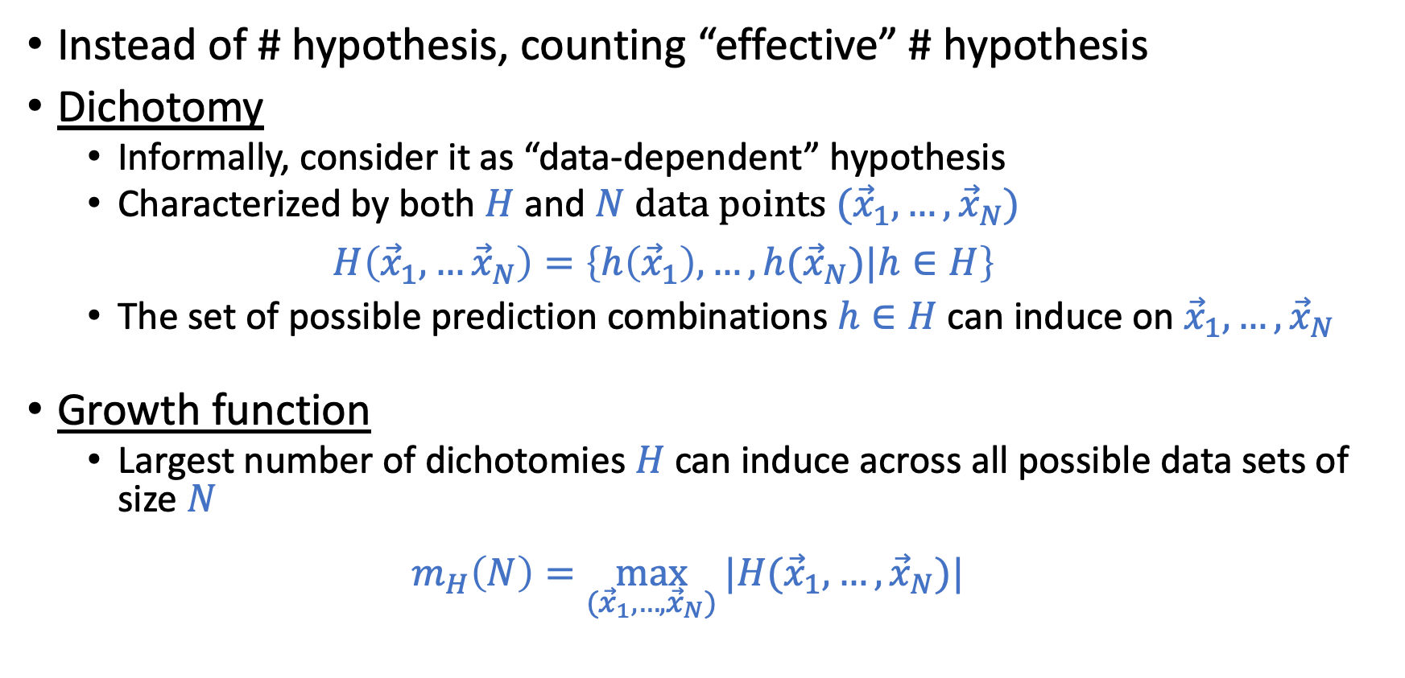

Dealing with Infinite Hypothesis Set: $M→∞$
Instead of # hypothesis, counting “effective” # hypothesis
Dichotomy
Informally, consider it as “data-dependent” hypothesis
Characterized by both $H$ and $N$ data points $({\vec{x}}_{1},…,{\vec{x}}_{N})$ $H\left({\vec{x}}_{1},…{\vec{x}}_{N}\right)=\left\{h\left({\vec{x}}_{1}\right),…,h({\vec{x}}_{N})|h∈H\right\}$
The set of possible prediction combinations $h∈H$ can induce on${\vec{x}}_{1},…,{\vec{x}}_{N}$
Growth function
Largest number of dichotomies $H$can induce across all possible data sets of size $N$
$m_{H}\left(N\right)=\max_{({\vec{x}}_{1},…,{\vec{x}}_{N})}{|H({\vec{x}}_{1},…,{\vec{x}}_{N})|}$

Slide 12
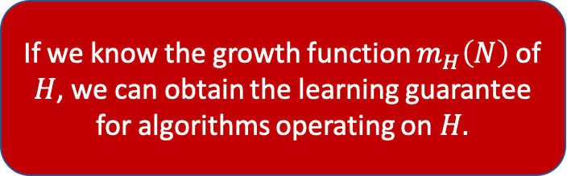
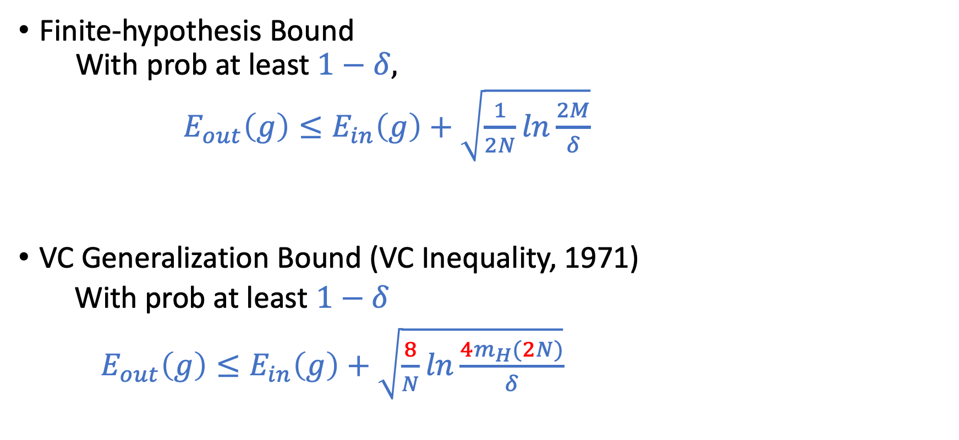
Why Growth Function?
Finite-hypothesis Bound With prob at least $1−δ,$
$E_{out}\left(g\right)≤E_{in}\left(g\right)+\sqrt{\frac{1}{2N}ln\frac{2M}{δ}}$
VC Generalization Bound (VC Inequality, 1971)
With prob at least $1−δ$
$E_{out}\left(g\right)≤E_{in}\left(g\right)+\sqrt{\frac{8}{N}ln\frac{4m_{H}(2N)}{δ}}$
If we know the growth function $m_{H}\left(N\right)$ of $H$, we can obtain the learning guarantee for algorithms operating on $H.$

Slide 13
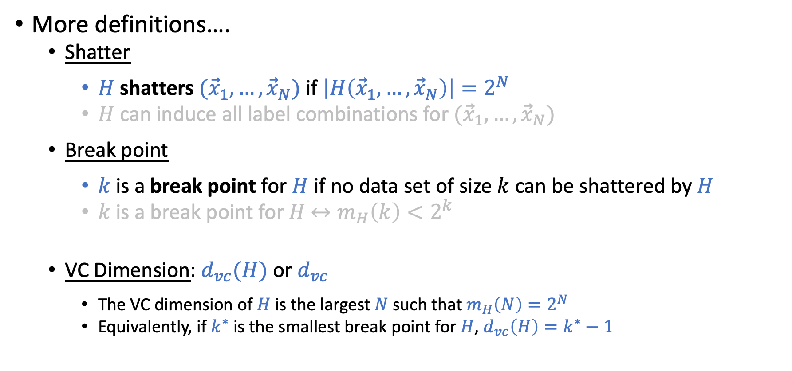
Bounding Growth Functions
More definitions….
Shatter
$H$ shatters $({\vec{x}}_{1},…,{\vec{x}}_{N})$ if $\left|H\left({\vec{x}}_{1},…,{\vec{x}}_{N}\right)\right|=2^{N}$
$H$ can induce all label combinations for $({\vec{x}}_{1},…,{\vec{x}}_{N})$
Break point
$k$ is a break point for $H$ if no data set of size $k$ can be shattered by $H$
$k$ is a break point for $H$ $↔m_{H}\left(k\right)<2^{k}$
VC Dimension: $d_{vc}(H)$ or $d_{vc}$
The VC dimension of $H$ is the largest $N$ such that $m_{H}\left(N\right)=2^{N}$
Equivalently, if $k^{∗}$ is the smallest break point for $H$, $d_{vc}\left(H\right)=k^{∗}−1$

Slide 14

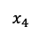
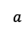
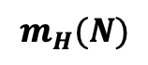
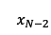
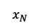
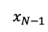
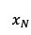
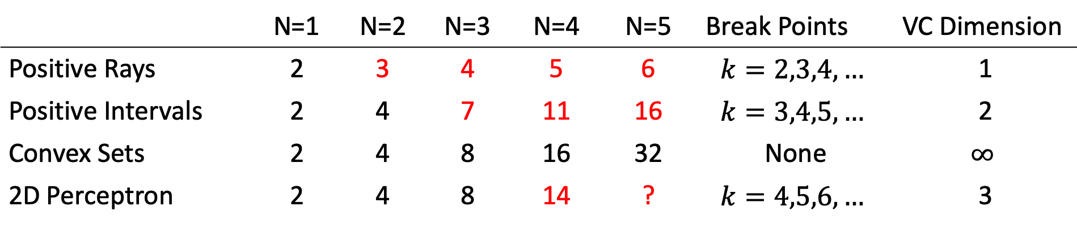
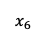
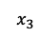
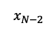
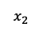
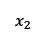
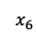
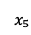
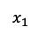
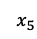
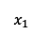
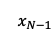
Examples
$$m_{H}(N)$$
 | N=1 | N=2 | N=3 | N=4 | N=5 | Break Points | VC Dimension
Positive Rays | 2 | 3 | 4 | 5 | 6 | $$k=2,3,4,…$$ | 1
Positive Intervals | 2 | 4 | 7 | 11 | 16 | $$k=3,4,5,…$$ | 2
Convex Sets | 2 | 4 | 8 | 16 | 32 | None | $$∞$$
2D Perceptron | 2 | 4 | 8 | 14 | ? | $$k=4,5,6,…$$ | 3
Positive Rays
Positive Intervals
Convex Sets
2D Perceptron
Predict -1
Predict +1
Predict -1
Predict +1
Predict -1
Predcit +1
…
$$x_{1}$$
$$x_{2}$$
$$x_{3}$$
$$x_{4}$$
$$x_{5}$$
$$x_{6}$$
…
$$x_{N−2}$$
$$x_{N−1}$$
$$x_{N}$$
Predict -1
$$x_{1}$$
$$x_{2}$$
$$x_{3}$$
$$x_{4}$$
$$x_{5}$$
$$x_{6}$$
$$x_{N−2}$$
$$x_{N−1}$$
$$x_{N}$$
$$a$$
$$a$$
$$b$$

Slide 15
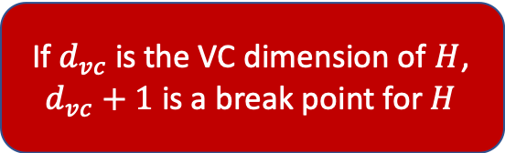
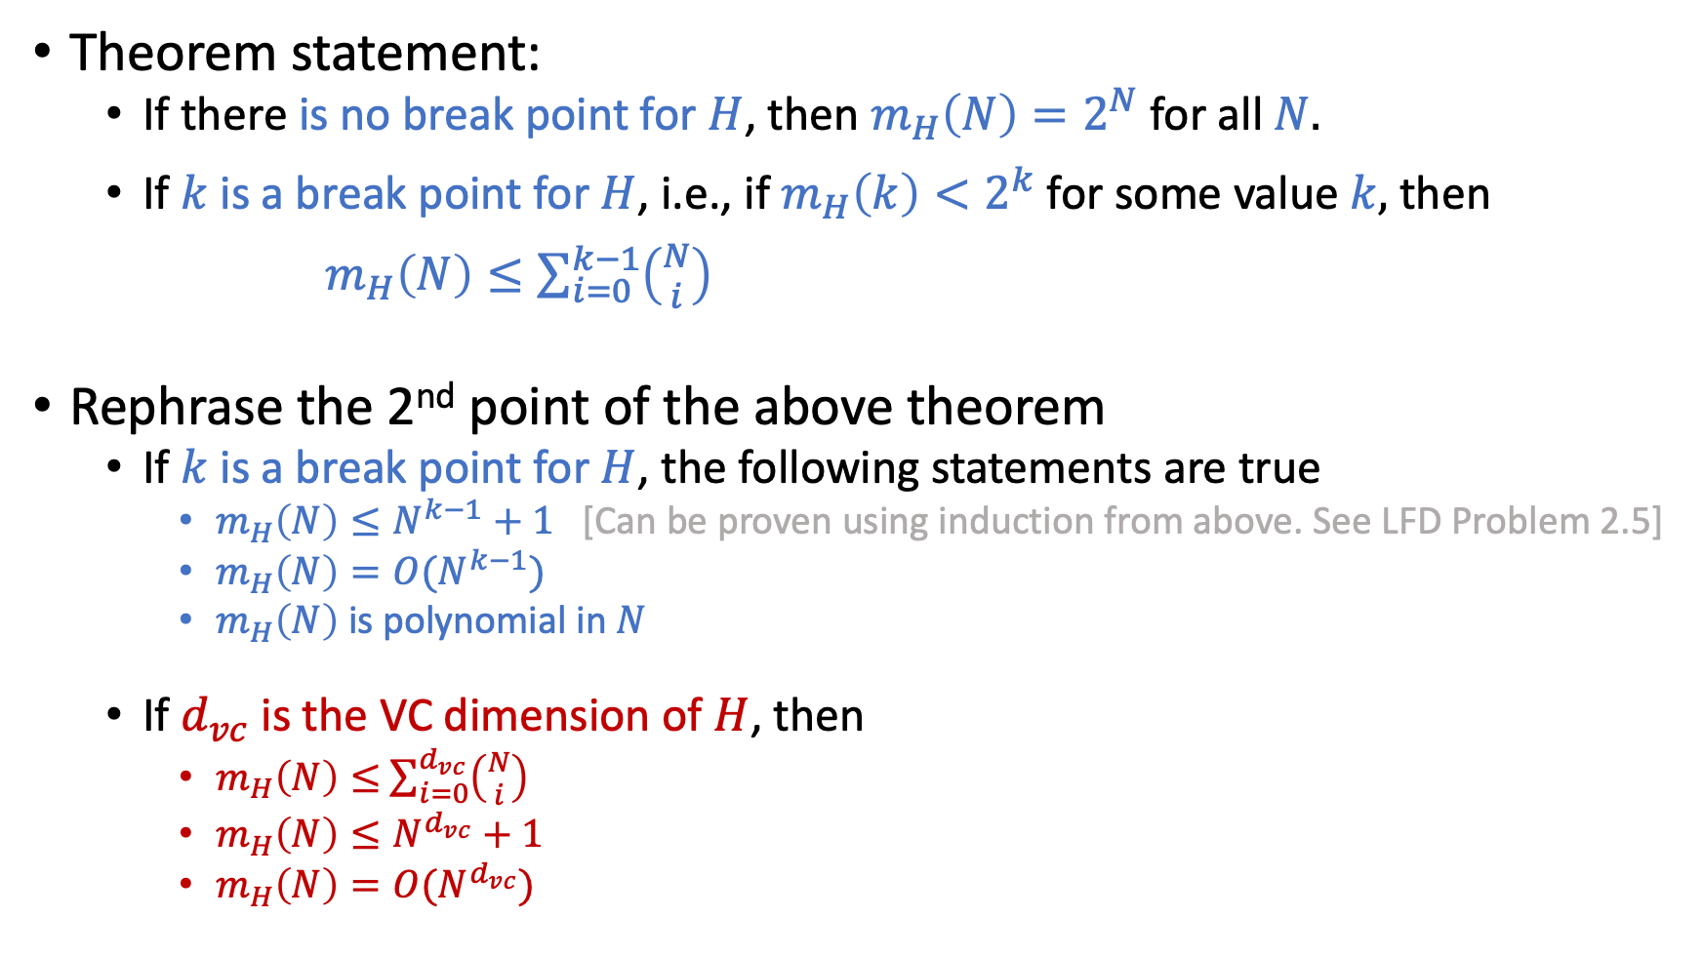
Bounding Growth Functions using Break Points
Theorem statement:
If there is no break point for $H$, then $m_{H}\left(N\right)=2^{N}$ for all $N.$
If $k$ is a break point for $H$, i.e., if $m_{H}\left(k\right)<2^{k}$ for some value $k,$ then
$m_{H}\left(N\right)≤\sum_{i=0}^{k−1}{\left({N \atop i}\right)}$
Rephrase the 2nd point of the above theorem
If $k$ is a break point for $H$, the following statements are true
$m_{H}\left(N\right)≤N^{k−1}+1$ [Can be proven using induction from above. See LFD Problem 2.5]
$m_{H}\left(N\right)=O(N^{k−1})$
$m_{H}\left(N\right)$ is polynomial in $N$
If $d_{vc}$ is the VC dimension of $H$, then
$m_{H}\left(N\right)≤$ $\sum_{i=0}^{d_{vc}}{\left({N \atop i}\right)}$
$m_{H}\left(N\right)≤N^{d_{vc}}+1$
$m_{H}\left(N\right)=O(N^{d_{vc}})$
If $d_{vc}$ is the VC dimension of $H$, $d_{vc}+1$ is a break point for $H$

Slide 16
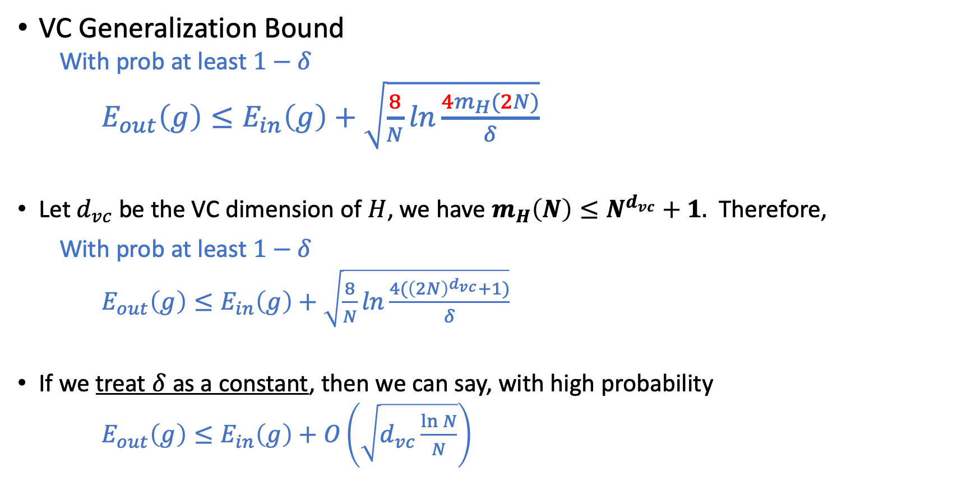
Vapnik–Chervonenkis (VC) Bound
VC Generalization Bound
With prob at least $1−δ$
$E_{out}\left(g\right)≤E_{in}\left(g\right)+\sqrt{\frac{8}{N}ln\frac{4m_{H}(2N)}{δ}}$
Let $d_{vc}$ be the VC dimension of $H$, we have $m_{H}\left(N\right)≤N^{d_{vc}}+1.$ Therefore,
With prob at least $1−δ$
$E_{out}\left(g\right)≤E_{in}\left(g\right)+\sqrt{\frac{8}{N}ln\frac{4{(\left(2N\right)}^{d_{vc}}+1)}{δ}}$
If we treat $δ$ as a constant, then we can say, with high probability
$E_{out}\left(g\right)≤E_{in}\left(g\right)+O\left(\sqrt{d_{vc}\frac{\ln{N}}{N}}\right)$

Slide 17
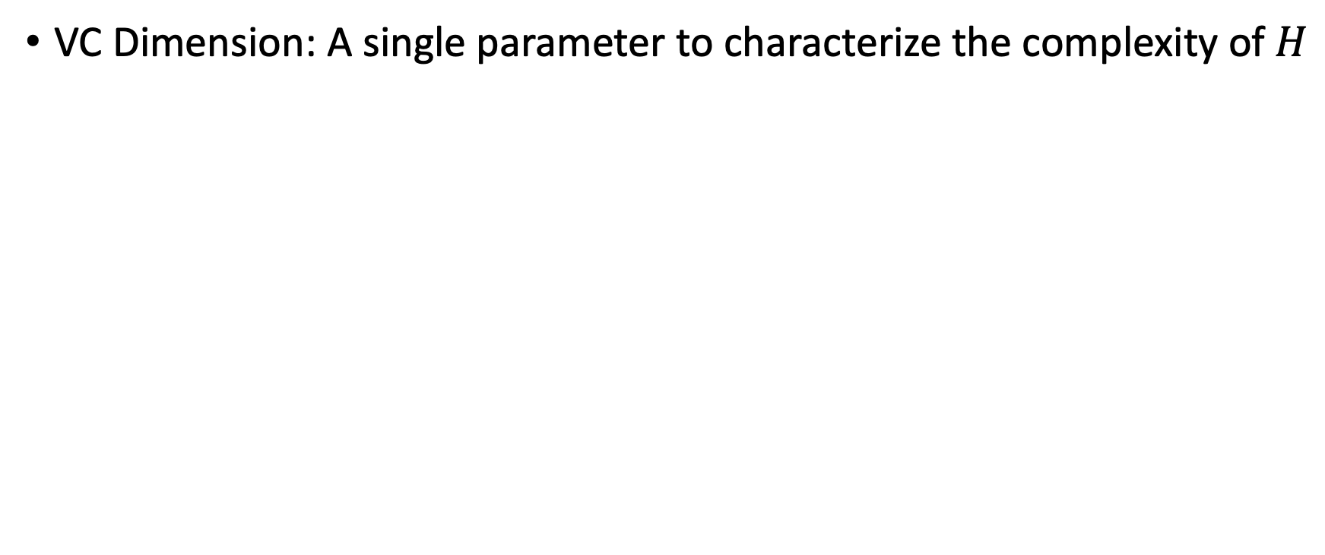

Approximation-Generalization Tradeoff
VC Dimension: A single parameter to characterize the complexity of $H$
$E_{out}\left(g\right)≤E_{in}\left(g\right)+O\left(\sqrt{d_{vc}\frac{\ln{N}}{N}}\right)$

Slide 18
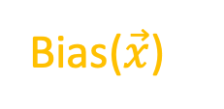
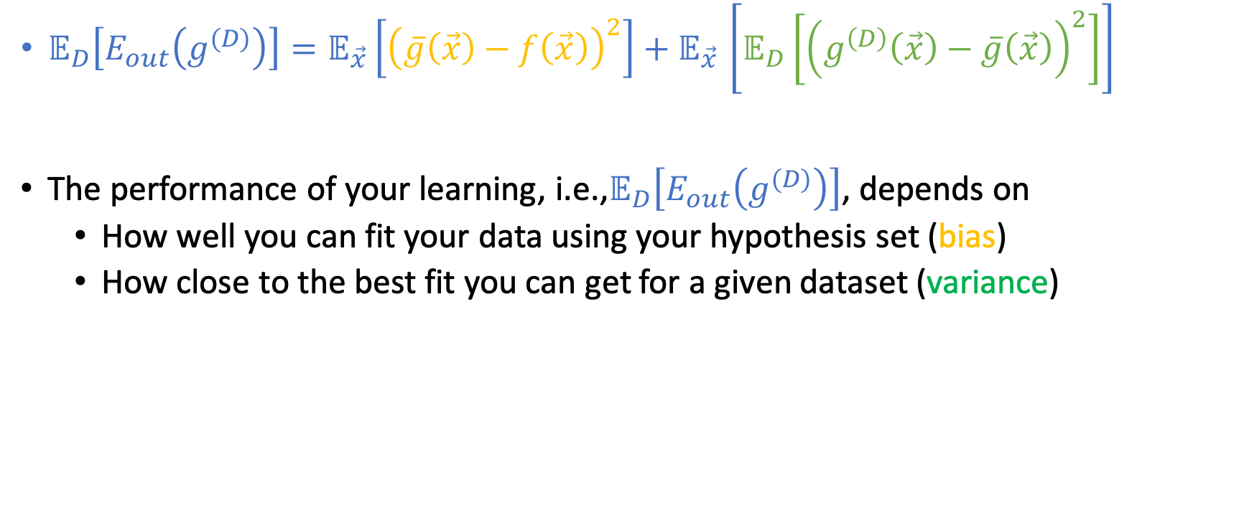
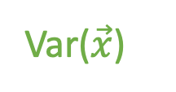
Bias-Variance Decomposition
Bias($\vec{x}$)
Var($\vec{x}$)
$𝔼_{D}\left[E_{out}\left(g^{(D)}\right)\right]{=𝔼_{\vec{x}}\left[{\left(\overline{g}\left(\vec{x}\right)−f\left(\vec{x}\right)\right)}^{2}\right]+𝔼}_{\vec{x}}\left[𝔼_{D}\left[{\left(g^{\left(D\right)}\left(\vec{x}\right)−\overline{g}\left(\vec{x}\right)\right)}^{2}\right]\right]$
The performance of your learning, i.e.,$𝔼_{D}\left[E_{out}\left(g^{(D)}\right)\right]$, depends on
How well you can fit your data using your hypothesis set (bias)
How close to the best fit you can get for a given dataset (variance)

Slide 19
Learning Curves

Slide 20
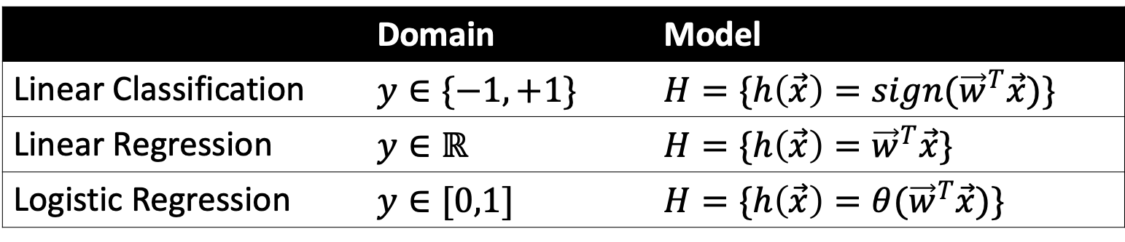
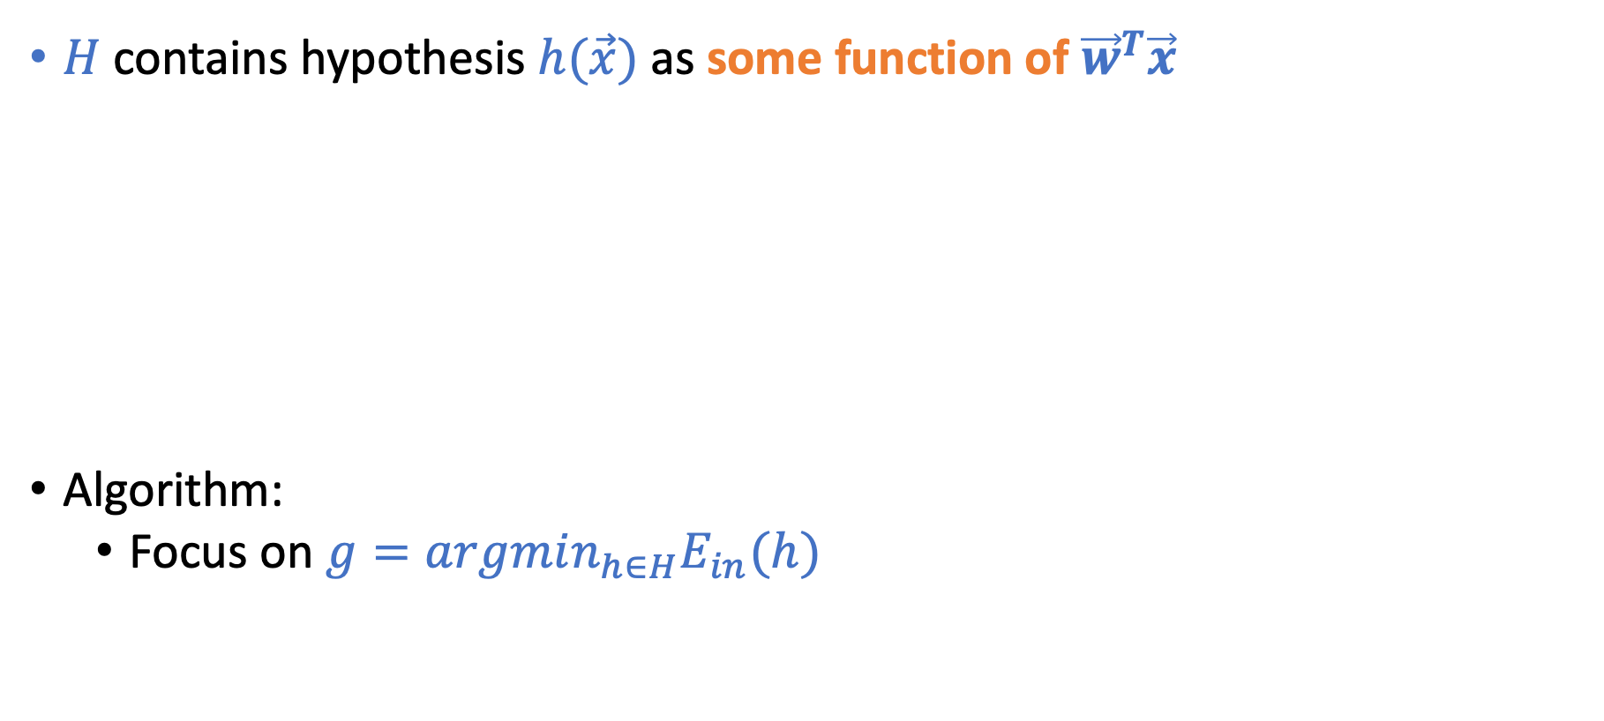
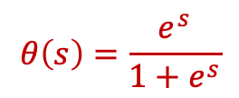
Linear Models
This is why it’s called linear models
$H$ contains hypothesis $h(\vec{x})$ as some function of ${\vec{w}}^{T}\vec{x}$
Algorithm:
Focus on $g=argmin_{h∈H}E_{in}(h)$
 | Domain | Model
Linear Classification | $$y∈\{−1,+1\}$$ | $$H=\{h\left(\vec{x}\right)={sign(\vec{w}}^{T}\vec{x})\}$$
Linear Regression | $$y∈ℝ$$ | $$H=\{h\left(\vec{x}\right)={\vec{w}}^{T}\vec{x}\}$$
Logistic Regression | $$y∈[0,1]$$ | $$H=\{h\left(\vec{x}\right)={θ(\vec{w}}^{T}\vec{x})\}$$
$$θ\left(s\right)=\frac{e^{s}}{1+e^{s}}$$

Slide 21

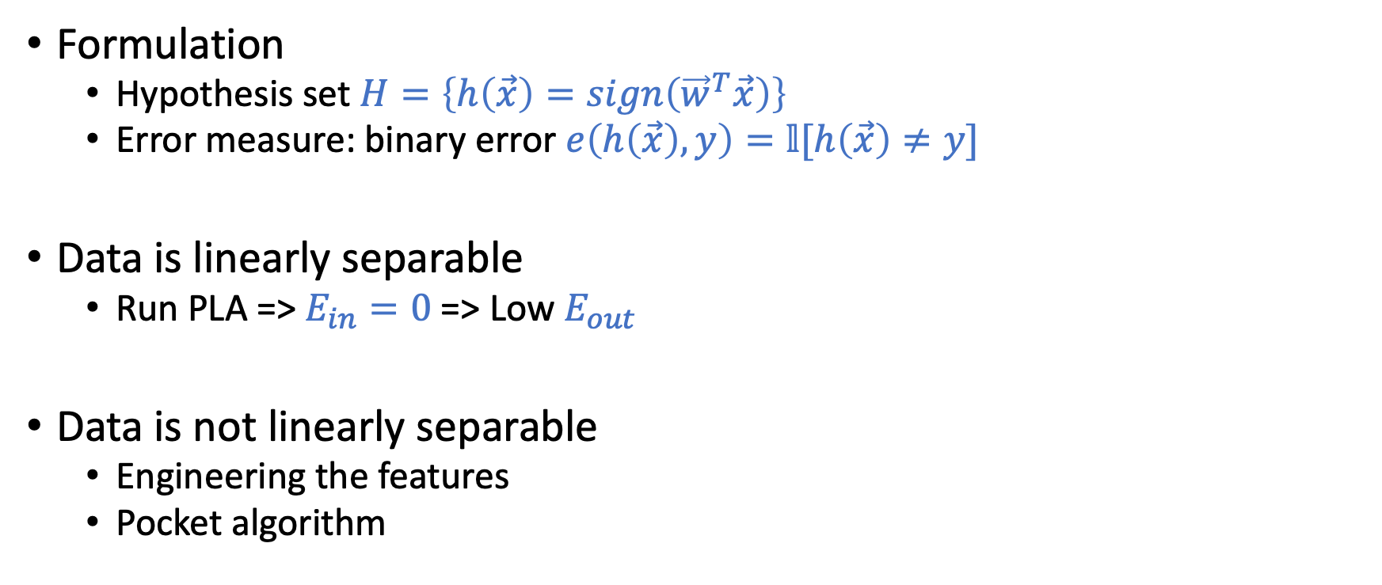
Linear Classification
Formulation
Hypothesis set $H=\left\{h\left(\vec{x}\right)=sign\left({\vec{w}}^{T}\vec{x}\right)\right\}$
Error measure: binary error $e\left(h\left(\vec{x}\right),y\right)=𝕝[h\left(\vec{x}\right)≠y]$
Data is linearly separable
Run PLA => $E_{in}=0$ => Low $E_{out}$
Data is not linearly separable
Engineering the features
Pocket algorithm
Perceptron Learning Algorithm (PLA)
Initialize $\vec{w}\left(0\right)=\vec{0}$
For $t=0,…$
Find a misclassified example $\left(\vec{x}\left(t\right),y(t)\right)$ in $D$
that is, $sign(\vec{w}{\left(t\right)}^{T}\vec{x}\left(t\right))≠y(t)$
If no such sample exists
Return $\vec{w}\left(t\right)$
Else
$\vec{w}\left(t+1\right)←\vec{w}\left(t\right)+y(t)\vec{x}(t)$

Slide 22
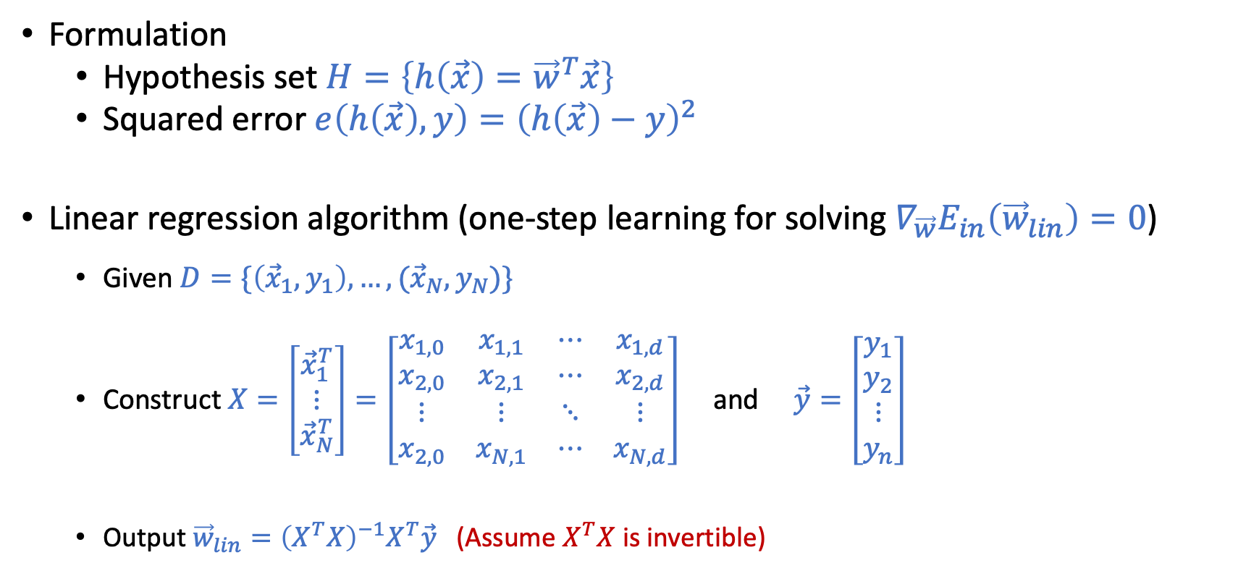
Linear Regression
Formulation
Hypothesis set $H=\left\{h\left(\vec{x}\right)={\vec{w}}^{T}\vec{x}\right\}$
Squared error $e\left(h\left(\vec{x}\right),y\right)={\left(h\left(\vec{x}\right)−y\right)}^{2}$
Linear regression algorithm (one-step learning for solving $∇_{\vec{w}}E_{in}\left({\vec{w}}_{lin}\right)=0$)
Given $D=\{\left({\vec{x}}_{1},y_{1}\right),…,({\vec{x}}_{N},y_{N})\}$
Construct $X=\left[\begin{matrix}{\vec{x}}_{1}^{T} \\ ⋮ \\ {\vec{x}}_{N}^{T}\end{matrix}\right]=\left[\begin{matrix}x_{1,0} & x_{1,1} & ⋯ & x_{1,d} \\ x_{2,0} & x_{2,1} & ⋯ & x_{2,d} \\ ⋮ & ⋮ & ⋱ & ⋮ \\ x_{2,0} & x_{N,1} & ⋯ & x_{N,d}\end{matrix}\right]$ and $\vec{y}=\left[\begin{matrix}y_{1} \\ y_{2} \\ ⋮ \\ y_{n}\end{matrix}\right]$
Output ${\vec{w}}_{lin}={\left(X^{T}X\right)}^{−1}X^{T}\vec{y}$ (Assume $X^{T}X$ is invertible)

Slide 23
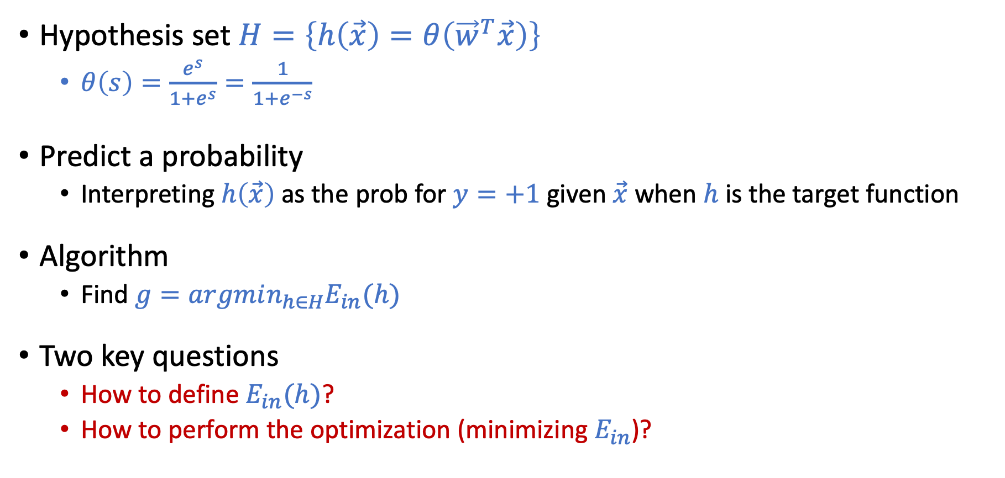
Logistic Regression
Hypothesis set $H=\left\{h\left(\vec{x}\right)=θ\left({\vec{w}}^{T}\vec{x}\right)\right\}$
$θ\left(s\right)=\frac{e^{s}}{1+e^{s}}=\frac{1}{1+e^{−s}}$
Predict a probability
Interpreting $h\left(\vec{x}\right)$ as the prob for $y=+1$ given $\vec{x}$ when $h$ is the target function
Algorithm
Find $g=argmin_{h∈H}E_{in}(h)$
Two key questions
How to define $E_{in}(h)$?
How to perform the optimization (minimizing $E_{in}$)?

Slide 24
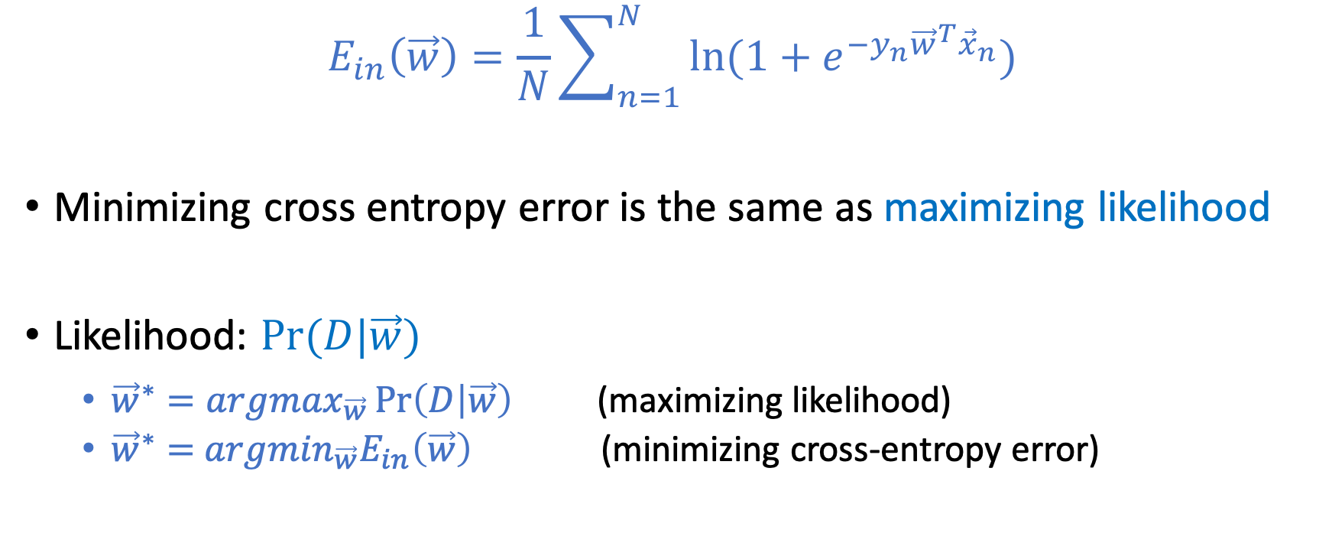
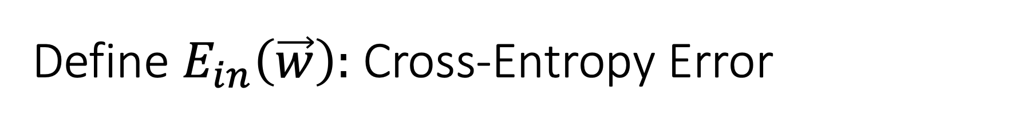
Define $E_{in}\left(\vec{w}\right):$ Cross-Entropy Error
$$E_{in}\left(\vec{w}\right)=\frac{1}{N}\sum_{n=1}^{N}{\ln{(1+e^{−y_{n}{\vec{w}}^{T}{\vec{x}}_{n}})}}$$
Minimizing cross entropy error is the same as maximizing likelihood
Likelihood: $Pr⁡(D|\vec{w})$
${\vec{w}}^{∗}=argmax_{\vec{w}}\operatorname{Pr}\left(D | \vec{w}\right)$ (maximizing likelihood)
${\vec{w}}^{∗}=$ $argmin_{\vec{w}}E_{in}\left(\vec{w}\right)$ (minimizing cross-entropy error)

Slide 25
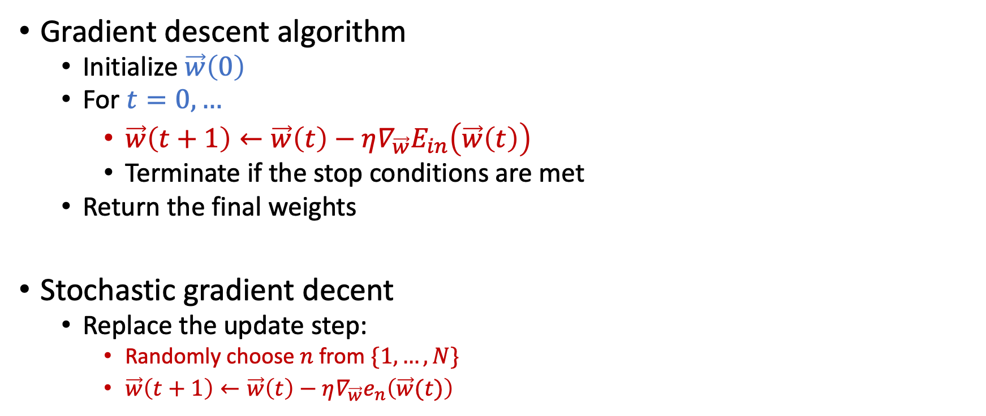
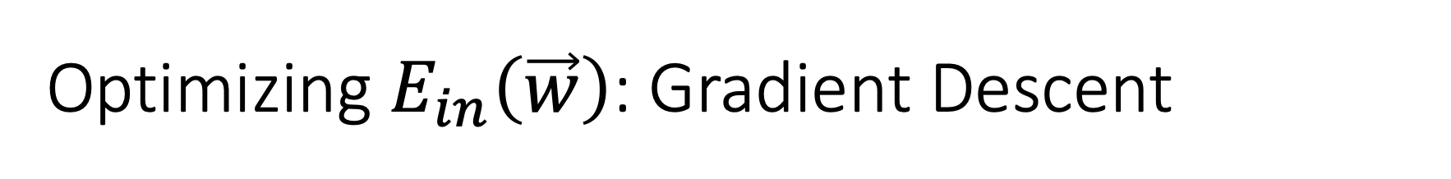
Optimizing $E_{in}\left(\vec{w}\right)$: Gradient Descent
Gradient descent algorithm
Initialize $\vec{w}\left(0\right)$
For $t=0,…$
$\vec{w}\left(t+1\right)←\vec{w}\left(t\right)−η∇_{\vec{w}}E_{in}\left(\vec{w}\left(t\right)\right)$
Terminate if the stop conditions are met
Return the final weights
Stochastic gradient decent
Replace the update step:
Randomly choose $n$ from $\{1,…,N\}$
$\vec{w}\left(t+1\right)←\vec{w}\left(t\right)−η∇_{\vec{w}}e_{n}\left(\vec{w}(t)\right)$
Works for functions where gradient exists everywhere

Slide 26
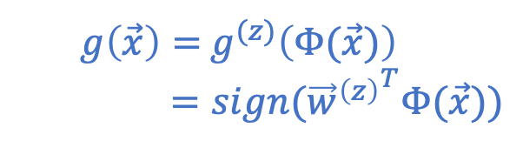
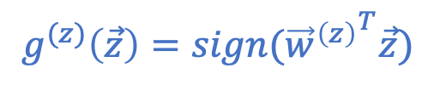
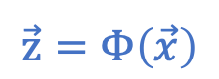
Nonlinear Transformation
$$\vec{z}=Φ\left(\vec{x}\right)$$
$$g^{(z)}\left(\vec{z}\right)=sign({{\vec{w}}^{\left(z\right)}}^{T}\vec{z})$$
$g\left(\vec{x}\right)=$ $g^{(z)}\left(Φ(\vec{x})\right)$
$=sign({{\vec{w}}^{\left(z\right)}}^{T}Φ(\vec{x}))$

Slide 27
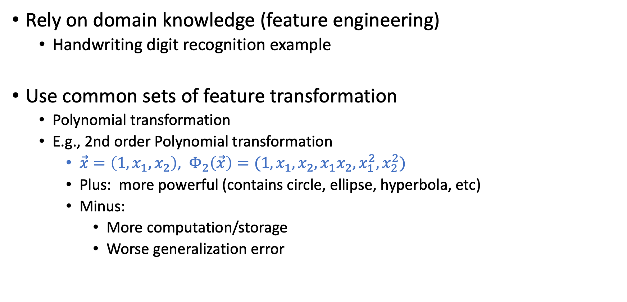

Must Choose $Φ$ BEFORE Looking at the Data
Rely on domain knowledge (feature engineering)
Handwriting digit recognition example
Use common sets of feature transformation
Polynomial transformation
E.g., 2nd order Polynomial transformation
$\vec{x}=\left(1,x_{1},x_{2}\right)$, $Φ_{2}\left(\vec{x}\right)=(1,x_{1},x_{2},x_{1}x_{2},x_{1}^{2},x_{2}^{2})$
Plus: more powerful (contains circle, ellipse, hyperbola, etc)
Minus:
More computation/storage
Worse generalization error
The VC dimension of d-dim perceptron is d+1

Slide 28
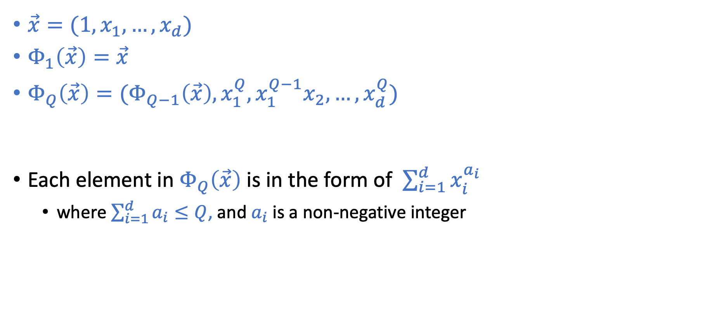
Q-th Order Polynomial Transform
$\vec{x}=(1,x_{1},…,x_{d})$
$Φ_{1}\left(\vec{x}\right)=\vec{x}$
$Φ_{Q}\left(\vec{x}\right)=(Φ_{Q−1}\left(\vec{x}\right),x_{1}^{Q},x_{1}^{Q−1}x_{2},…,x_{d}^{Q})$
Each element in $Φ_{Q}\left(\vec{x}\right)$ is in the form of $\sum_{i=1}^{d}{x_{i}^{a_{i}}}$
where $\sum_{i=1}^{d}{a_{i}}≤Q$, and $a_{i}$ is a non-negative integer
Number of elements in $Φ_{Q}\left(\vec{x}\right)$: $\left(\begin{matrix}Q+d \\ Q\end{matrix}\right)$ (including the initial 1)

Slide 29

Overfitting and Its Cures
Overfitting
Fitting the data more than is warranted
Fitting the noise instead of the pattern of the data
Decreasing $E_{in}$ but getting larger $E_{out}$
When $H$ is too strong, but $N$ is not large enough
Regularization
Intuition: Constraining $H$to make overfitting less likely to happen
Validation
Intuition: Reserve data to estimate $E_{out}$

Slide 30




Regularization
minimize $E_{in}\left(\vec{w}\right)$
subject to ${\vec{w}}^{T}\vec{w}≤C$
Constrain $H$
Example: Weight decay
Finding $g$=> Constrained optimization
Define augmented error
$E_{aug}\left(h,λ,Ω\right)=E_{in}\left(\vec{w}\right)+\frac{λ}{N}Ω\left(h\right)$
Finding $g$ => Unconstrained optimization
The two interpretations are conceptually equivalent in a lot of cases.
Understand the impacts of choosing $Ω$ and $λ$
$$H\left(C\right)=\left\{h∈H_{Q} \text{and} {\vec{w}}^{T}\vec{w}≤C\right\}$$
minimize $E_{in}\left(\vec{w}\right)+\frac{λ_{C}}{N}{\vec{w}}^{T}\vec{w}$

Slide 31


Validations
Reserving data to estimate $E_{out}$
Model Selection
 | Outlook | Relationship to $E_{out}$
$$E_{in}$$ | Incredibly optimistic | VC-bound
$$E_{val}$$ (when used for model selection) | Slightly optimistic | Hoeffding’s bound (multiple hypotheses)
$$E_{test}$$ | Unbiased | Hoeffding’s bound (single hypothesis)

Slide 32


Cross Validation
Split $D$ into $V$ equally sized data sets: $D_{1},D_{2},…,D_{V}$
Let $g_{i}^{−}$ be the hypothesis learned using all data sets except $D_{i}$
Let $e_{i}=E_{val}\left(g_{i}^{−}\right)$ where the validation uses data set $D_{i}$
The $V$-fold cross validation error is $\frac{1}{V}\sum_{i=1}^{V}{e_{i}}$
Leave-One-Out Cross Validation (LOOCV): $V=N$
$$d_{2}$$
$$d_{3}$$
$$y$$
$$d_{1}$$
$$x$$
$$x$$
$$x$$
$$E_{cv}= \frac{1}{3}\left(d_{1}^{2}+d_{2}^{2}+d_{3}^{2}\right)$$

Slide 33
Three Learning Principles
Occam’s Razor
The simplest model that fits the data is also the most plausible
Sampling Bias
If the data is sampled in a biased way, learning will produce a similarly biased outcome.
Data Snooping
If a data set has affected any step in the learning process, its ability to assess the outcome has been compromised.

Slide 34
Practice Questions
Don’t view these as good representations of exam questions.
But it should give you a sense of what the exam questions might look like.

Slide 35

What to Expect for Exam Questions
50 points in total
5 (+/- 1) long questions, 30 points
Written response questions with explanations required
Might earn partial credits
10 multiple choice questions, 20 points
No explanations needed
No partial credits
No penalty for choosing the wrong answer
Mark your selection clearly

Slide 36

Notes:
Reject for all

Slide 37

Notes:
1 -> B
2 -> C
3 -> D
4 -> A

Slide 38

Notes:
memorization

Slide 39


Slide 40

Notes:
3 and 4

Slide 41


Slide 42


